Slide 1

Computer Programming for Engineers
Week 5 Lecture 1
Sep. 27, 2022
Lecturer: Mohammad Mahdi Javidan
College of Engineering, Sungkyunkwan University
Fall Semester 2022

Slide 2
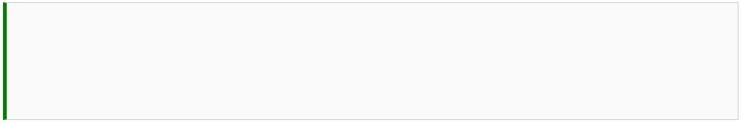
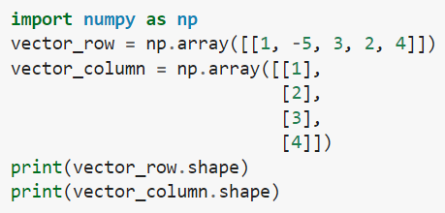


Vector
Vector is an n-tuple or a point in $ℝ^{n}$
A vector can be written in a row vector or a column vector
College of Engineering, Sungkyunkwan University

Slide 3
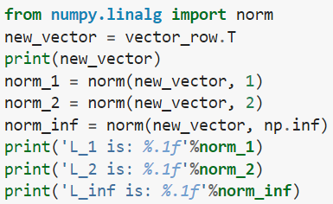
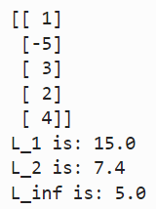
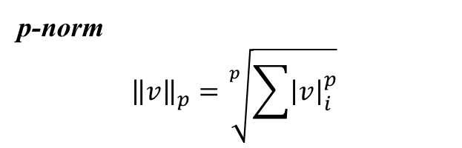

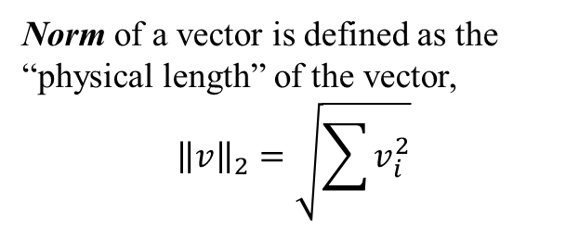
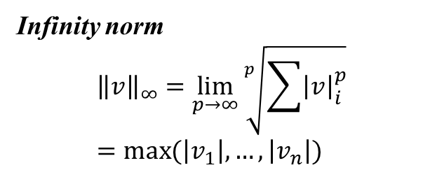
Vector
Norm of a vector is defined as the “physical length” of the vector,
$${\left\|v\right\|}_{2}=\sqrt{\sum{v_{i}^{2}}}$$
Taxicab Norm or Manhattan Norm
$${\left\|v\right\|}_{1}=\sum{\left|v_{i}\right|}$$
p-norm
$${\left\|v\right\|}_{p}=\sqrt[p]{\sum{{\left|v\right|}_{i}^{p}}}$$
Infinity norm
$${\left\|v\right\|}_{∞}=\lim_{p→∞}{\sqrt[p]{\sum{{\left|v\right|}_{i}^{p}}}}=\max{(\left|v_{1}\right|, …,\left|v_{n}\right|)}$$
College of Engineering, Sungkyunkwan University

Slide 4
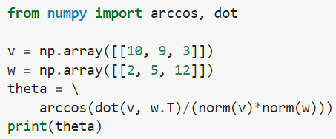



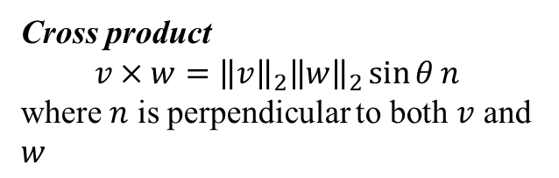
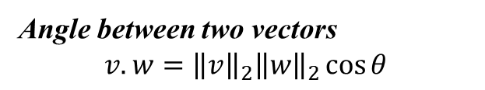
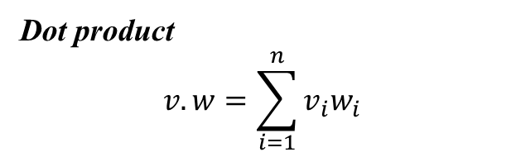
Vector
Dot product
$$v.w=\sum_{i=1}^{n}{v_{i}w_{i}}$$
Angle between two vectors
$$v.w={\left\|v\right\|}_{2}{\left\|w\right\|}_{2}\cos{θ}$$
Cross product
$$v×w={\left\|v\right\|}_{2}{\left\|w\right\|}_{2}\sin{θ}n$$
where $n$ is perpendicular to both $v$ and $w$
College of Engineering, Sungkyunkwan University

Slide 5
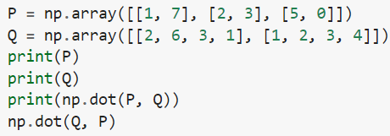
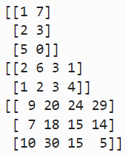
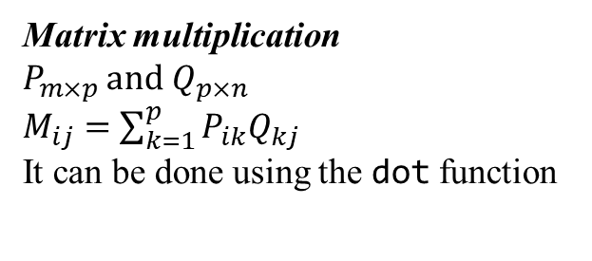
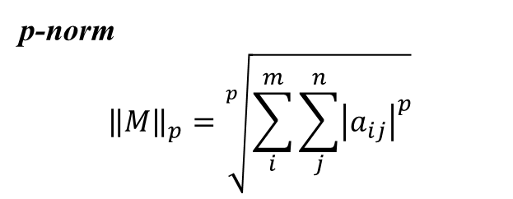
Matrices
p-norm
$${\left\|M\right\|}_{p}=\sqrt[p]{\sum_{i}^{m}{\sum_{j}^{n}{{\left|a_{ij}\right|}^{p}}}}$$
Matrix multiplication
$P_{m×p}$ and $Q_{p×n}$
$M_{ij}=$ $\sum_{k=1}^{p}{P_{ik}Q_{kj}}$
It can be done using the dot function
Transpose of a matrix can be using the same method as vectors
College of Engineering, Sungkyunkwan University

Slide 6
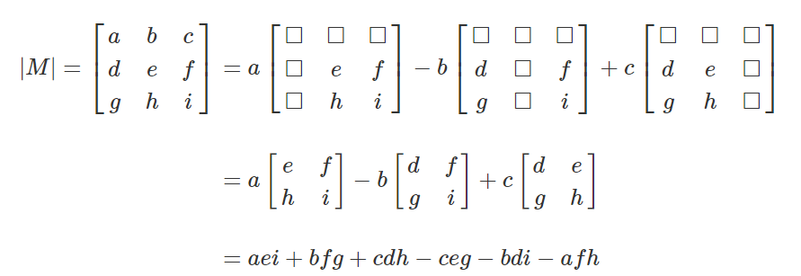
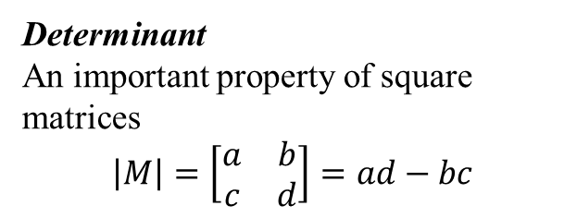
Matrices
Determinant
An important property of square matrices
$$\left|M\right|=\left[\begin{matrix}a & b \\ c & d\end{matrix}\right]=ad−bc$$
Laplace Expansion
$m_{ij}$ is the minor of $M$ obtained by removing the $i$th row and the $j$th column and obtaining the determinant
The $(i,j)$ cofactor of each element $cof(a_{ij})={(−1)}^{i+j}m_{ij}$
College of Engineering, Sungkyunkwan University

Slide 7
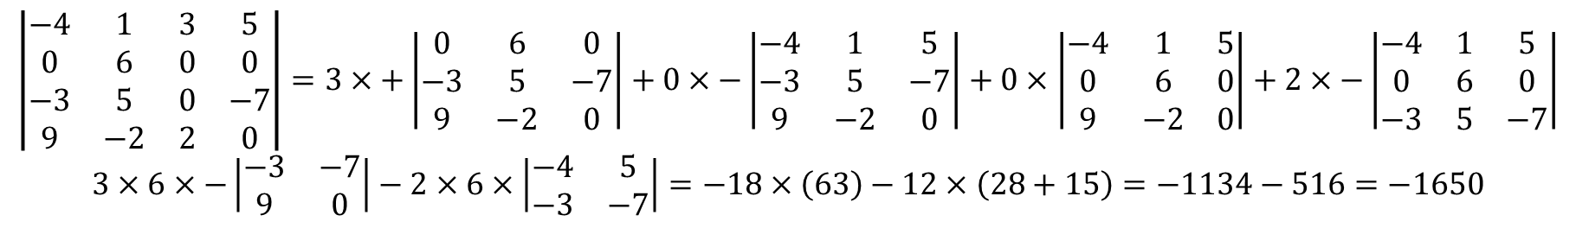
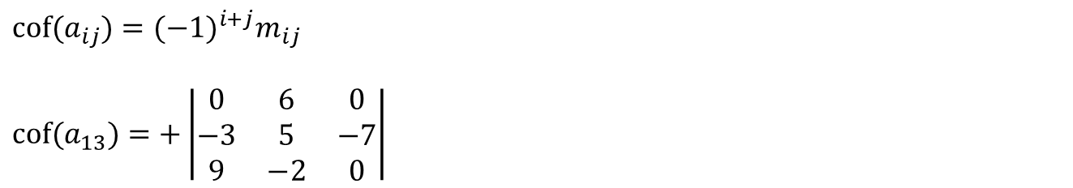
Laplace Expansion
Example
$$\left|\begin{matrix}−4 & 1 & 3 & 5 \\ 0 & 6 & 0 & 0 \\ −3 & 5 & 0 & −7 \\ 9 & −2 & 2 & 0\end{matrix}\right|=3×+\left|\begin{matrix}0 & 6 & 0 \\ −3 & 5 & −7 \\ 9 & −2 & 0\end{matrix}\right|+0×−\left|\begin{matrix}−4 & 1 & 5 \\ −3 & 5 & −7 \\ 9 & −2 & 0\end{matrix}\right|+0×\left|\begin{matrix}−4 & 1 & 5 \\ 0 & 6 & 0 \\ 9 & −2 & 0\end{matrix}\right|+2×−\left|\begin{matrix}−4 & 1 & 5 \\ 0 & 6 & 0 \\ −3 & 5 & −7\end{matrix}\right|$$
$$3×6×−\left|\begin{matrix}−3 & −7 \\ 9 & 0\end{matrix}\right|−2×6×\left|\begin{matrix}−4 & 5 \\ −3 & −7\end{matrix}\right|=−18×\left(63\right)−12×\left(28+15\right)=−1134−516=−1650$$
$$cof(a_{ij})={(−1)}^{i+j}m_{ij}$$
$$cof(a_{13})=+\left|\begin{matrix}0 & 6 & 0 \\ −3 & 5 & −7 \\ 9 & −2 & 0\end{matrix}\right|$$
College of Engineering, Sungkyunkwan University

Slide 8

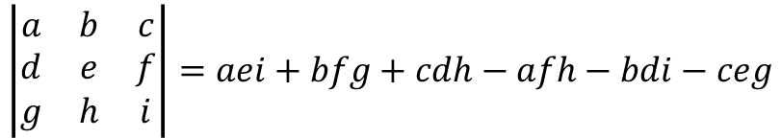

Matrices
Rule of Sarrus
$$\left|\begin{matrix}a & b & c \\ d & e & f \\ g & h & i\end{matrix}\right|$$
$$\left|\begin{matrix}a & b & c \\ d & e & f \\ g & h & i\end{matrix}\right|$$
$$\left|\begin{matrix}a & b & c \\ d & e & f \\ g & h & i\end{matrix}\right|=aei+bfg+cdh−afh−bdi−ceg$$
College of Engineering, Sungkyunkwan University

Slide 9
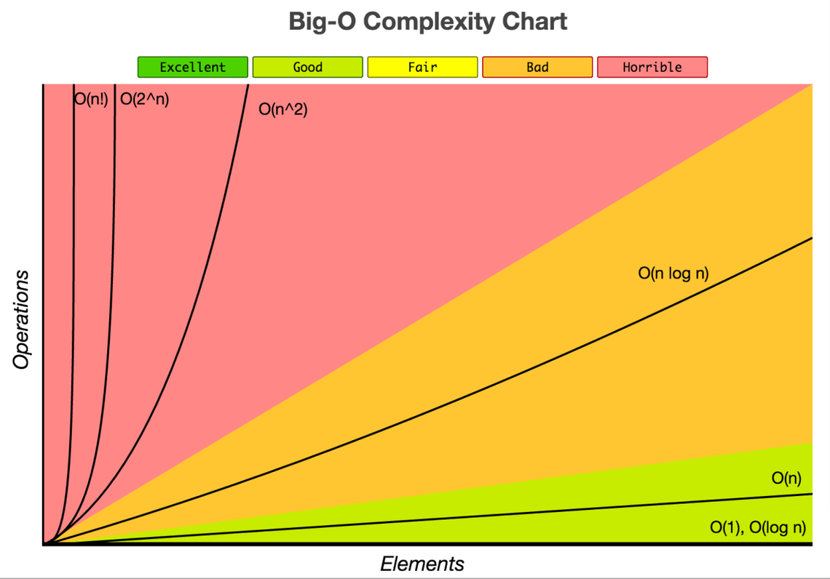
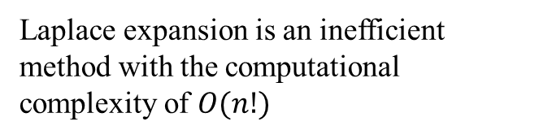
Matrices
Laplace expansion is an inefficient method with the computational complexity of $O(n!)$
College of Engineering, Sungkyunkwan University

Slide 10
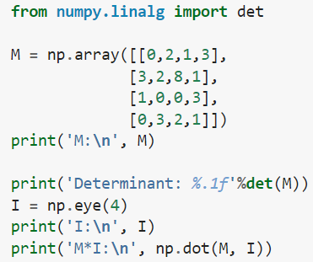
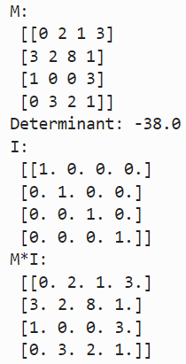
Matrices
Determinant can be calculated using the det function from the numpy.linalg package
Identity Matrix
A square matrix with one on the diagonal and zeros elsewhere
College of Engineering, Sungkyunkwan University

Slide 11
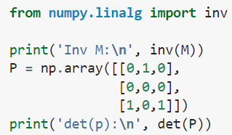

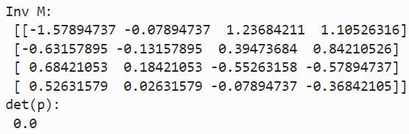
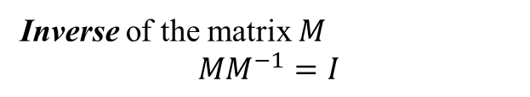
Matrices
Inverse of the matrix $M$
$$MM^{−1}=I$$
A Singular matrix is the one without an inverse. Nonsingular matrices are invertible.
College of Engineering, Sungkyunkwan University

Slide 12
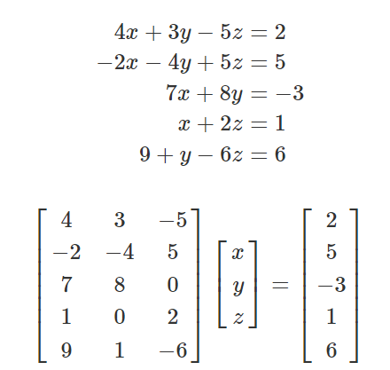
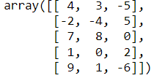


System of Linear Equations
$$9x$$
Row operations are:
Row swap
Scalar multiplication
Row sum
A rank of a matrix is the number of linearly independent rows or columns
College of Engineering, Sungkyunkwan University

Slide 13
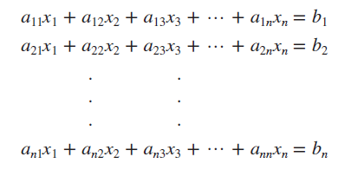
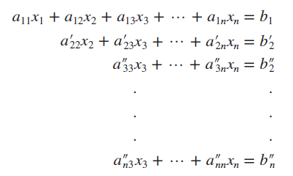

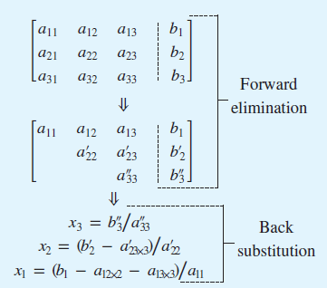

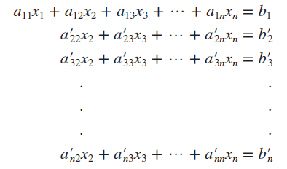
System of Linear Equations
Naïve Gauss Elimination
Pivot equation
Pivot coefficient
Augmented matrix
College of Engineering, Sungkyunkwan University

Slide 14
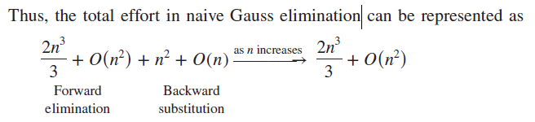
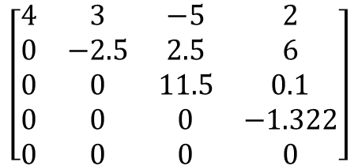
System of Linear Equations
$$\left[\begin{matrix}4 & 3 & −5 & 2 \\ 0 & −2.5 & 2.5 & 6 \\ 0 & 0 & 11.5 & 0.1 \\ 0 & 0 & 0 & −1.322 \\ 0 & 0 & 0 & 0\end{matrix}\right]$$
Gauss elimination
College of Engineering, Sungkyunkwan University

